Slide 1
useMemo in React

Slide 2
useMemo is a React Hook used to memoize values, caching the result of a calculation between re-renders.
In React useMemo Hook returns a memoized value and prevents the application from unnecessary re-renders.
It is useful in heavy computations and processes when using functional components.

Slide 3
useMemo is a handy tool in React that helps make your apps faster.
Imagine you have a function that does some heavy lifting, like calculating a complex math problem or formatting data.
Normally, React recalculates this function every time your component renders, even if the inputs are the same.
That can slow things down.

Slide 4
But with useMemo, React remembers the result of that function as long as its inputs stay the same. So, if your inputs don't change, React just grabs the stored result instead of recalculating it every time. This saves time and makes your app snappier.
In simple terms, useMemo is like having a smart assistant who remembers the answers to math problems, so you don't have to solve them again and again.

Slide 5
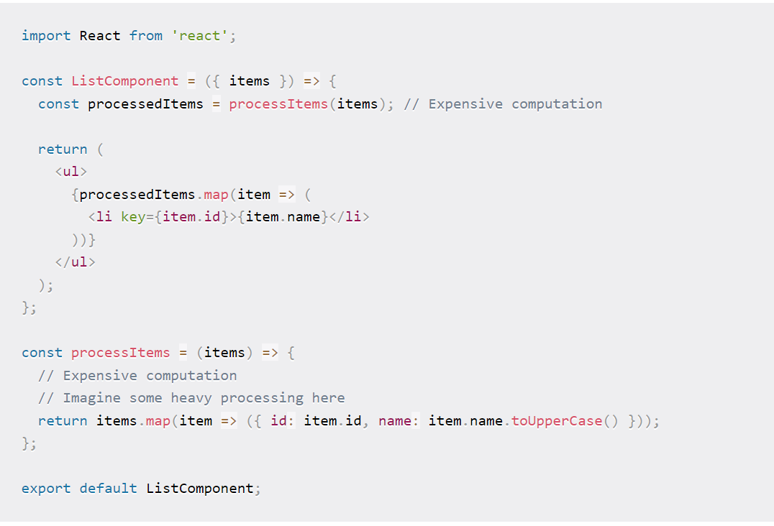

Slide 6
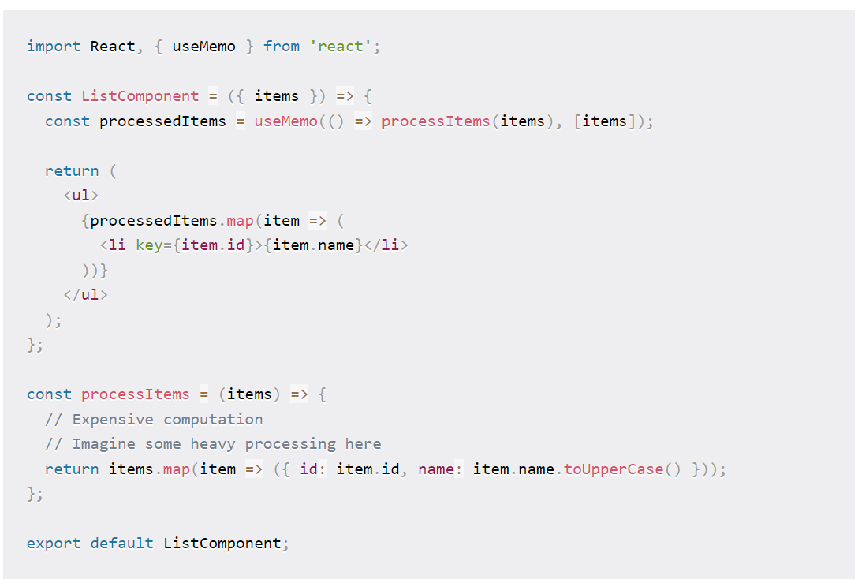
With useMemo()

Slide 7
Usecase 1 : Heavy Computation
Let's suppose we're building a tool to help users find all of the prime numbers between 0 and selectedNum, where selectedNum is a user-supplied value.
A prime number is a number that can only be divided by 1 and itself, like 17.

Slide 8
Create new react app
Create-react-app usememodemo

Slide 9
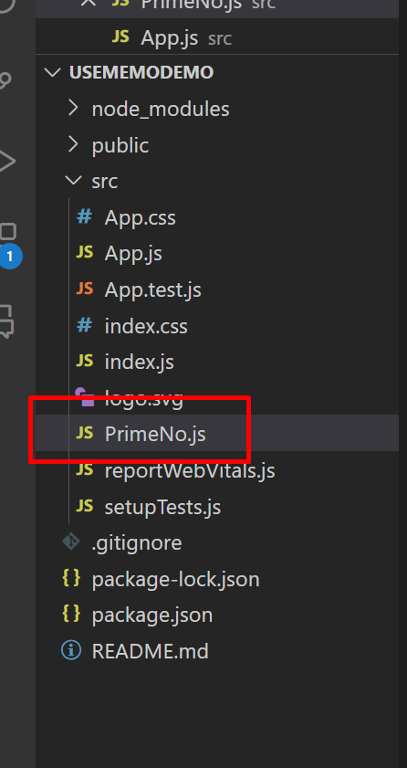
Inside src→create new file PrimeNo.js

Slide 10
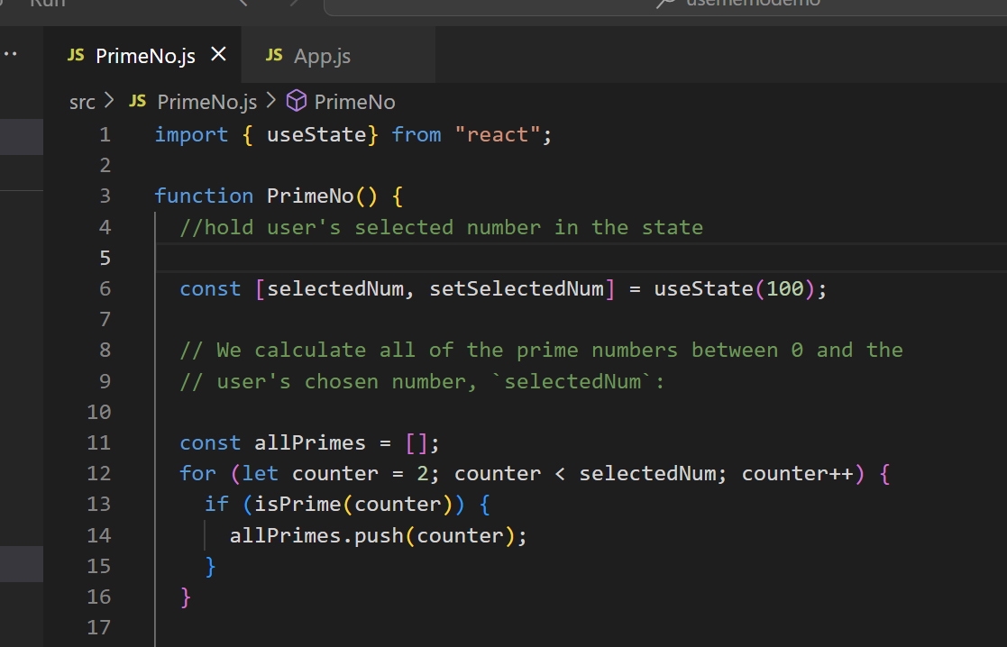
PrimeNo.js

Slide 11
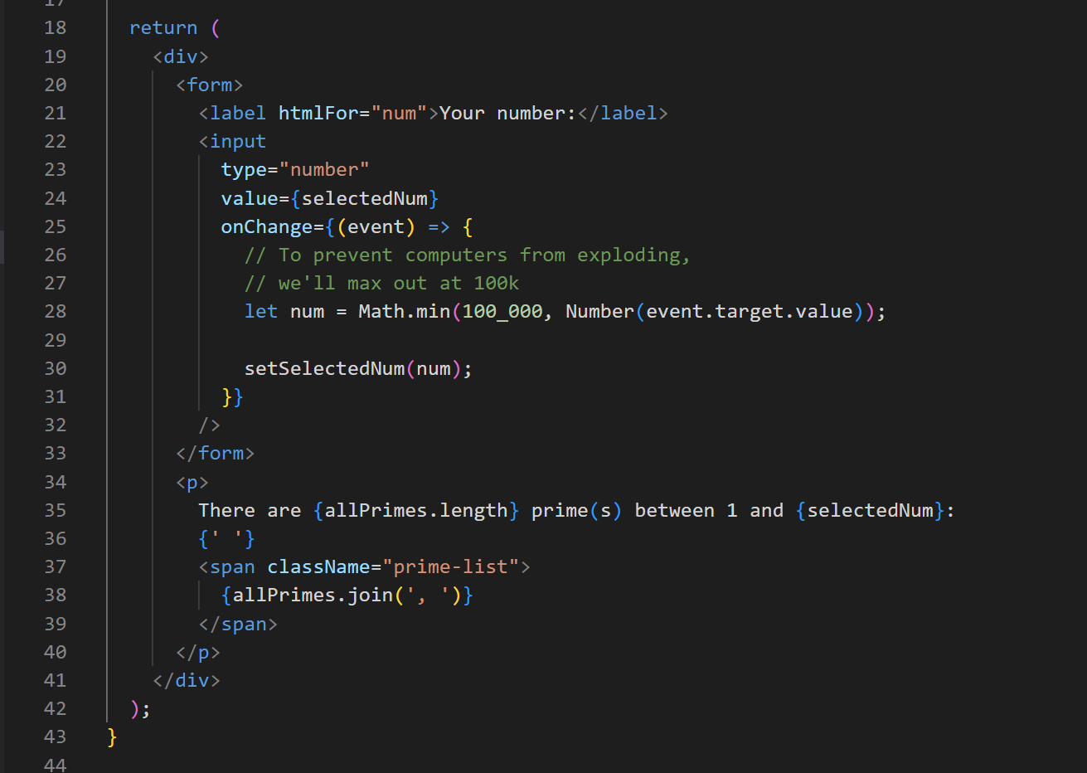

Slide 12
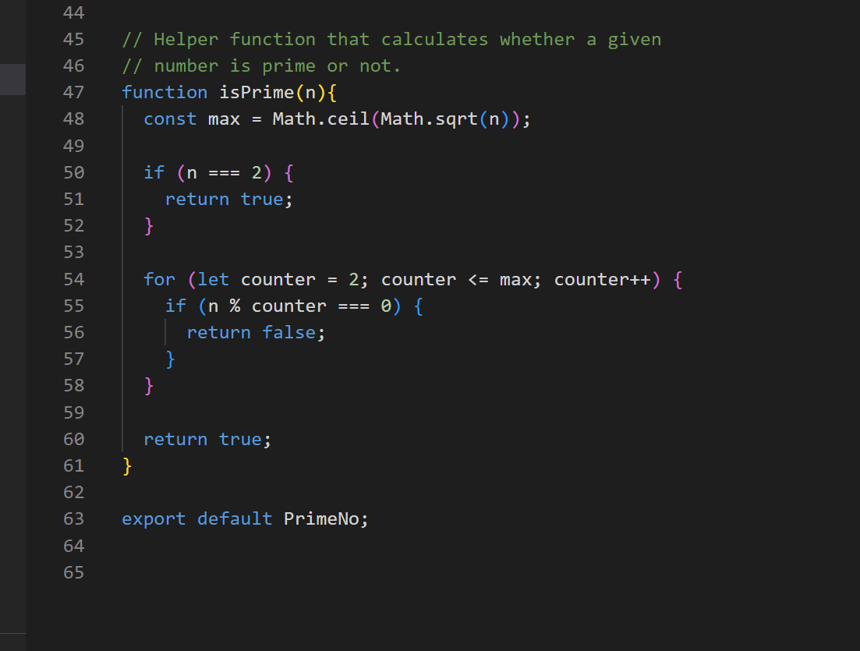

Slide 13
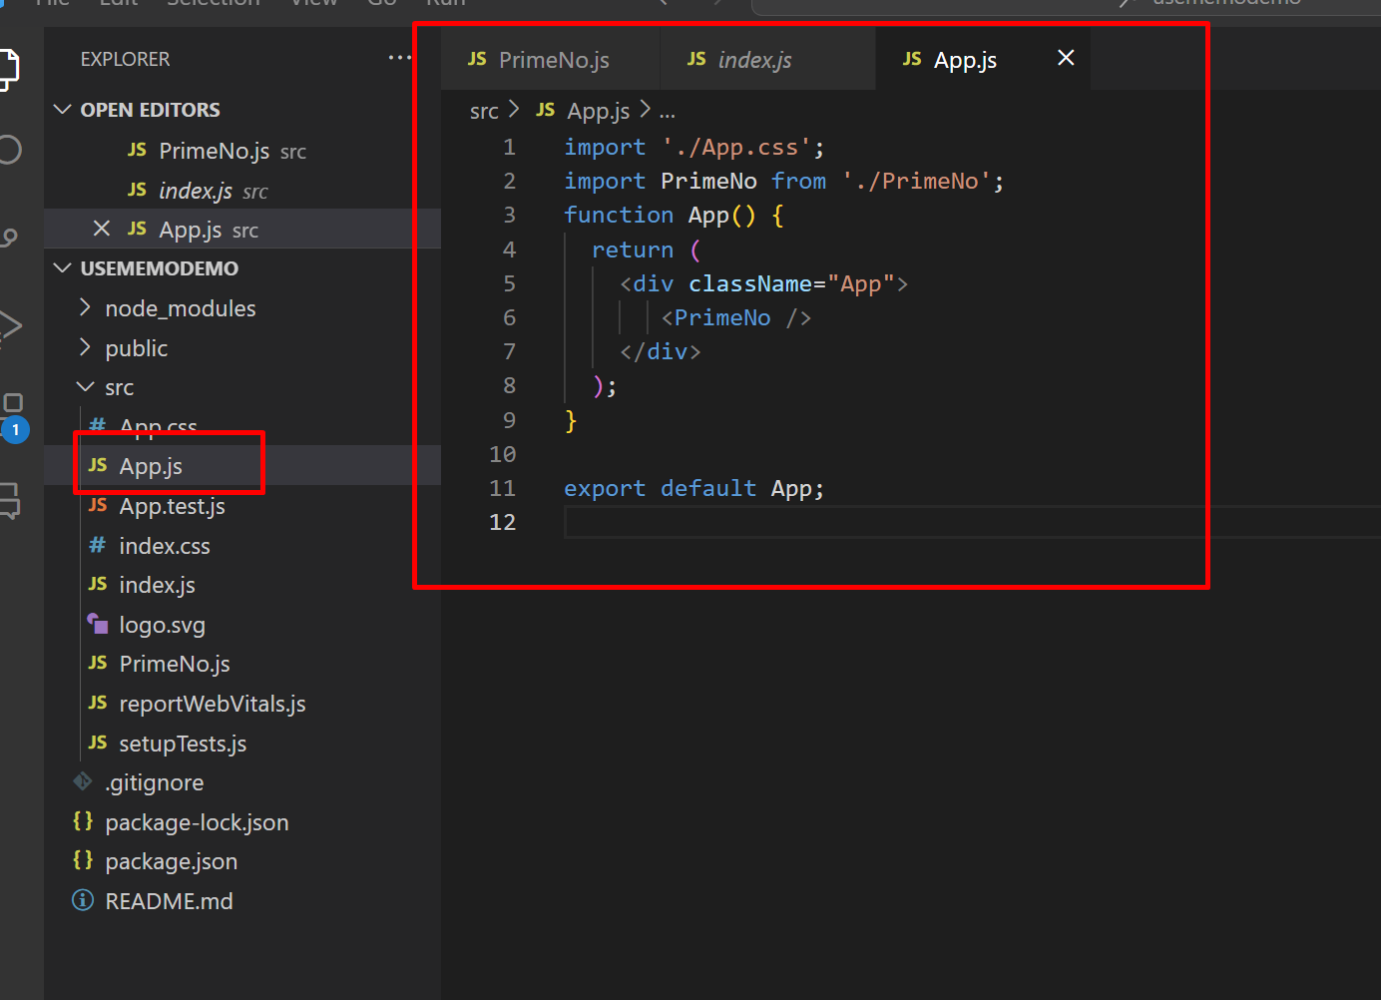
Import PrimeNo in App.js

Slide 14
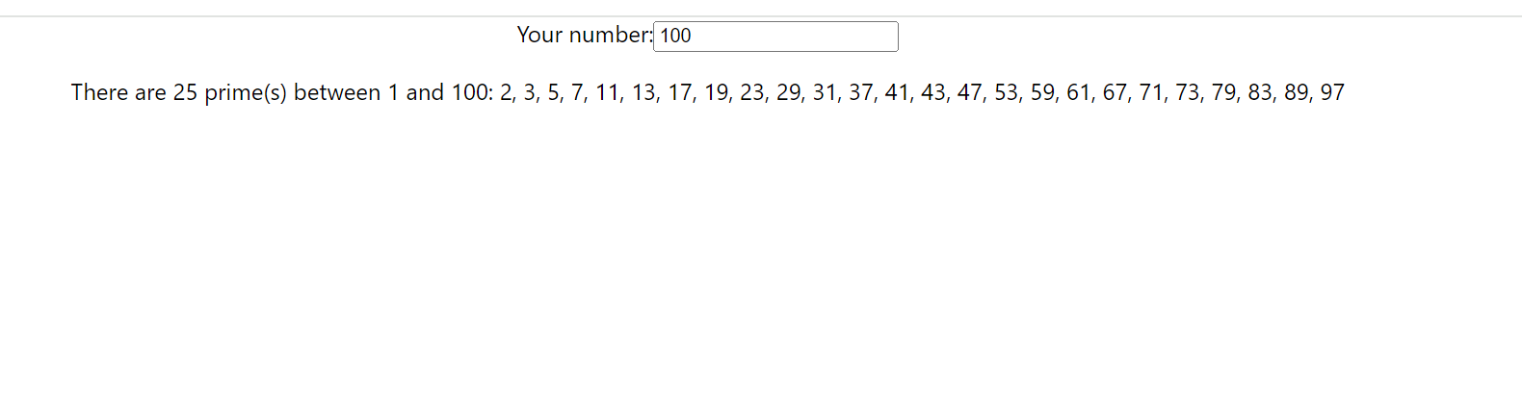
Run Application and check output.

Slide 15
This code requires a significant amount of computation. If the user picks a large selectedNum, we'll need to go through tens of thousands of numbers, checking if each one is prime.
And, while there are more efficient prime-checking algorithms than the one I used above, it's always going to be computationally intensive.

Slide 16
Now, say the example also feature digital clock.

Slide 17
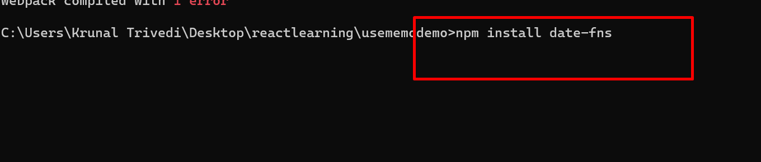
Install date-fns

Slide 18
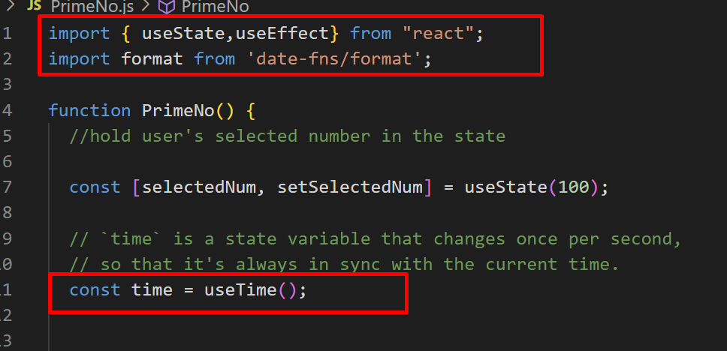
Modify PrimeNo.js file

Slide 19
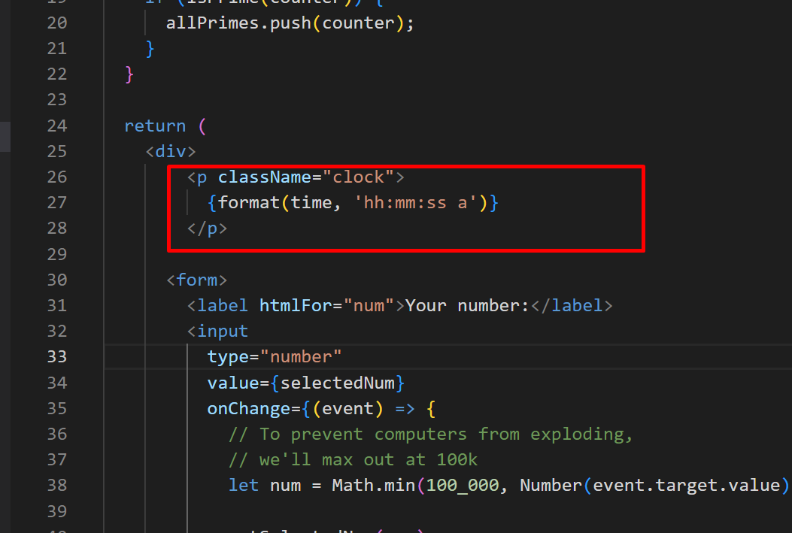

Slide 20
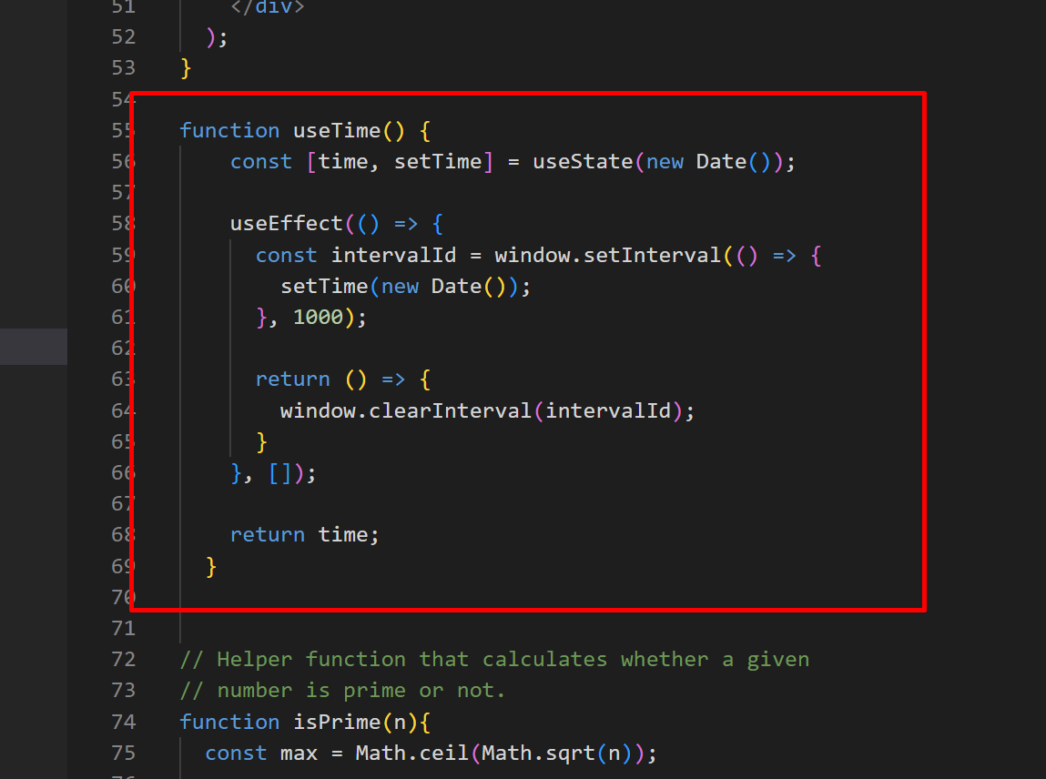
Create useTime() function

Slide 21
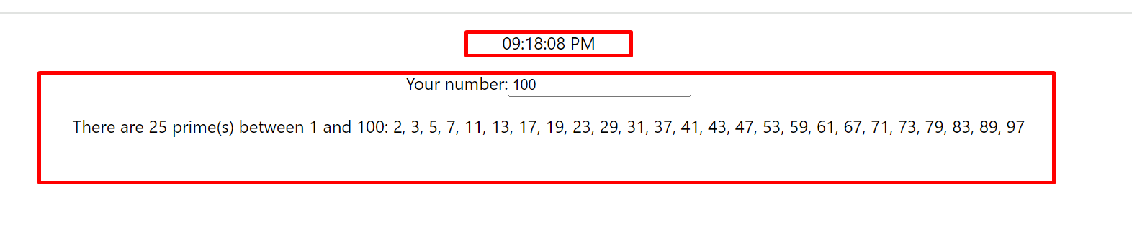

Slide 22
Our application now has two pieces of state, selectedNum and time. Once per second, the time variable is updated to reflect the current time, and that value is used to render a digital clock in the top-right corner.
Here's the issue: whenever either of these state variables change, we re-run all of those expensive prime-number computations. And because time changes once per second, it means we're constantly re-generating that list of primes, even when the user's selected number hasn't changed!

Slide 23
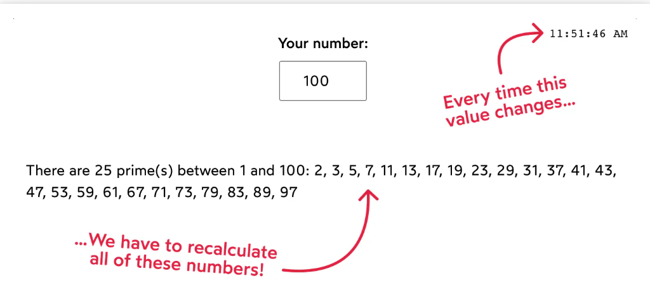

Slide 24
In JavaScript, we only have one main thread, and we're keeping it super busy by running this code over and over, every single second. It means that the application might feel sluggish as the user tries to do other things, especially on lower-end devices.

Slide 25
But what if we could “skip” these calculations? If we already have the list of primes for a given number, why not re-use that value instead of calculating it from scratch every time?
This is precisely what useMemo allows us to do.

Slide 26
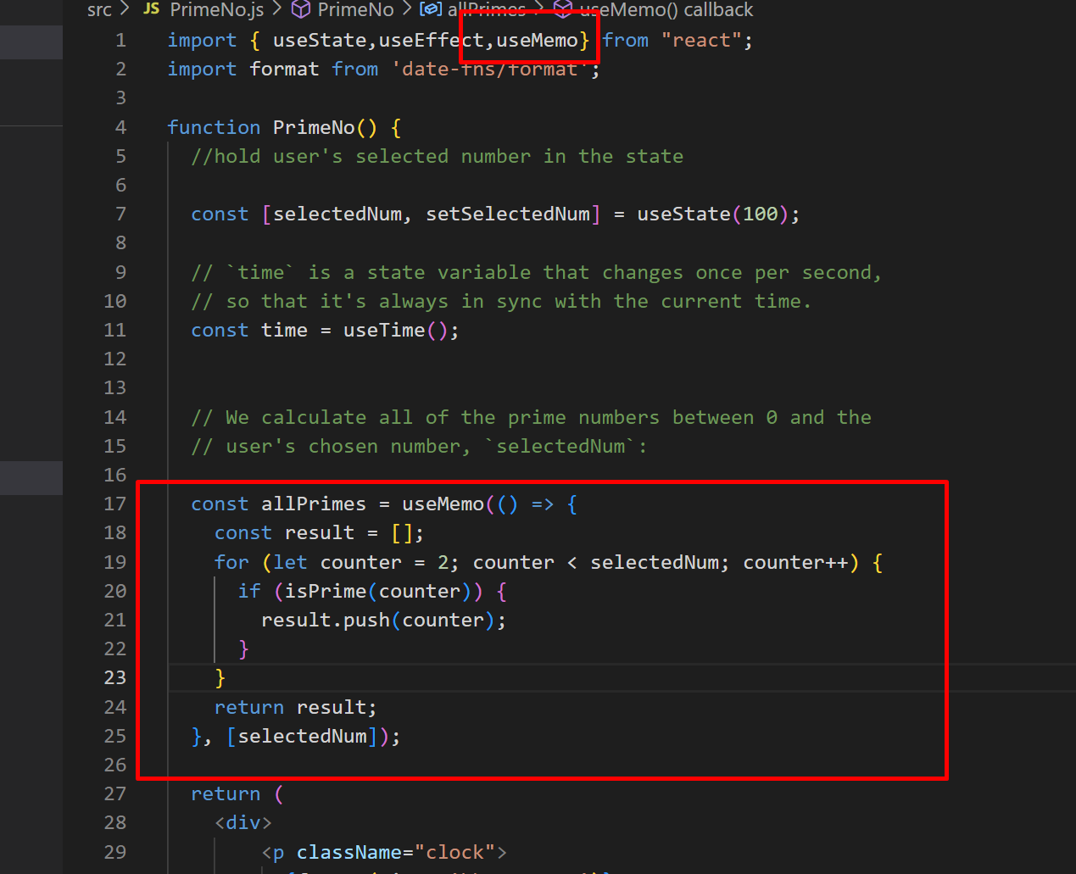

Slide 27
useMemo takes two arguments:
A chunk of work to be performed, wrapped up in a function
A list of dependencies
During mount, when this component is rendered for the very first time, React will invoke this function to run all of this logic, calculating all of the primes. Whatever we return from this function is assigned to the allPrimes variable.
For every subsequent render, however, React has a choice to make. Should it:
Invoke the function again, to re-calculate the value, or
Re-use the data it already has, from the last time it did this work.
To answer this question, React looks at the supplied list of dependencies. Have any of them changed since the previous render? If so, React will rerun the supplied function, to calculate a new value. Otherwise, it'll skip all that work and reuse the previously-calculated value.
useMemo is essentially like a lil’ cache, and the dependencies are the cache invalidation strategy.

Slide 28
In this case, we're essentially saying “recalculate the list of primes only when selectedNum changes”. When the component re-renders for other reasons (eg. the time state variable changing), useMemo ignores the function and passes along the cached value.
This is commonly known as memoization, and it's why this hook is called “useMemo”.

Slide 29
React.memo() is a higher-order component that we can use to wrap components that we do not want to re-render unless props within them change
useMemo() is a React Hook that we can use to wrap functions within a component. We can use this to ensure that the values within that function are re-computed only when one of its dependencies change

Slide 30
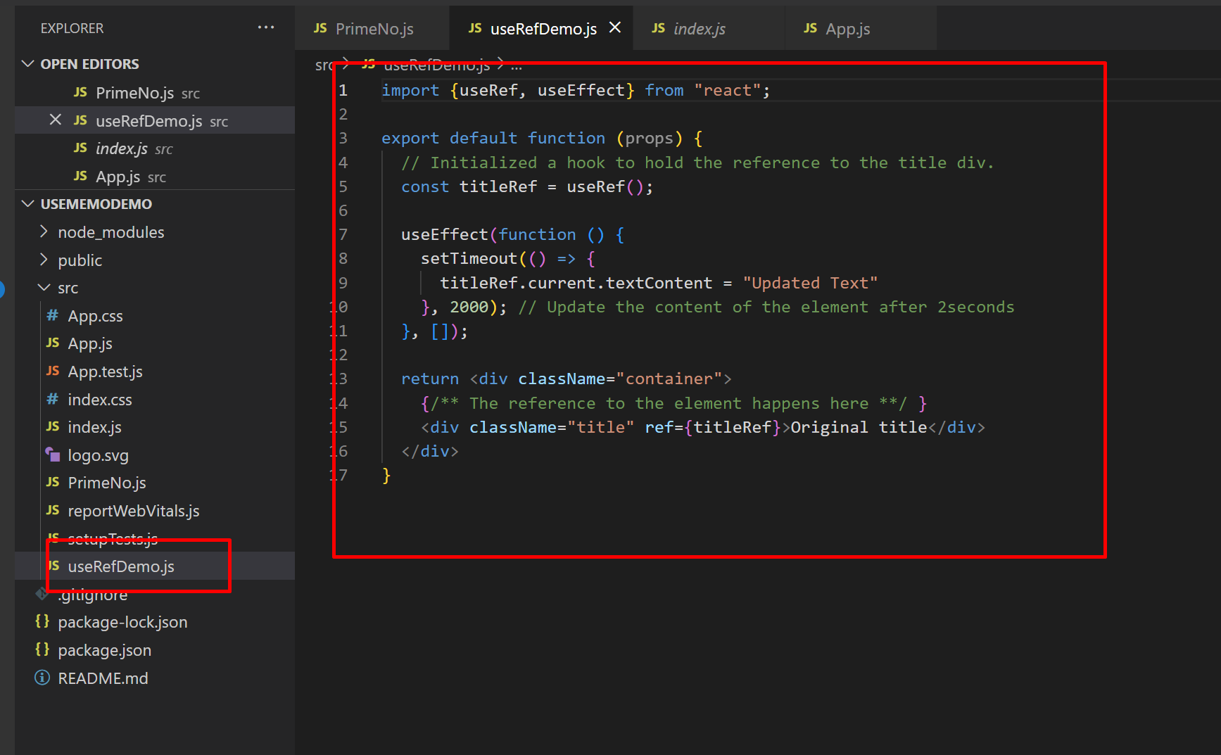
Now create useRefDemo.js and add the code

Slide 31
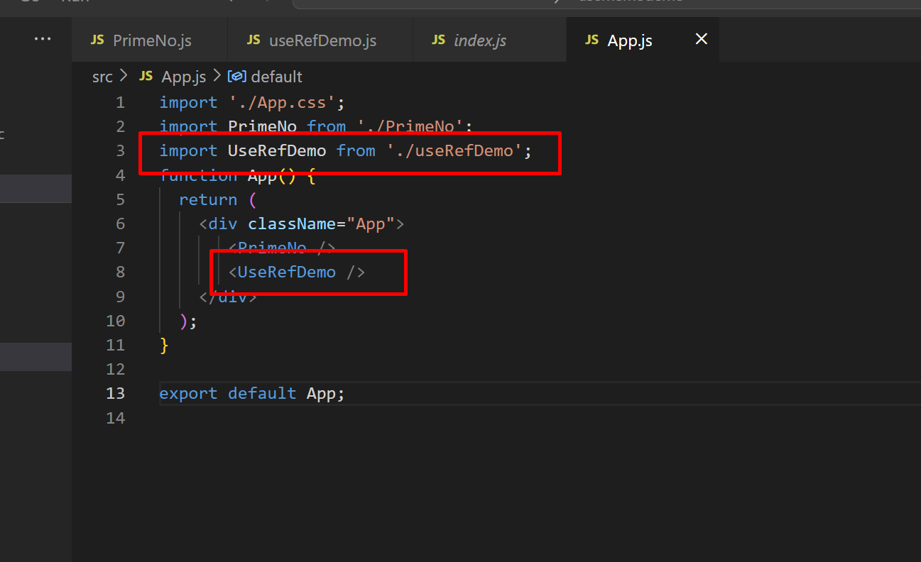
Import UseRefDemo in the App.js

Slide 32
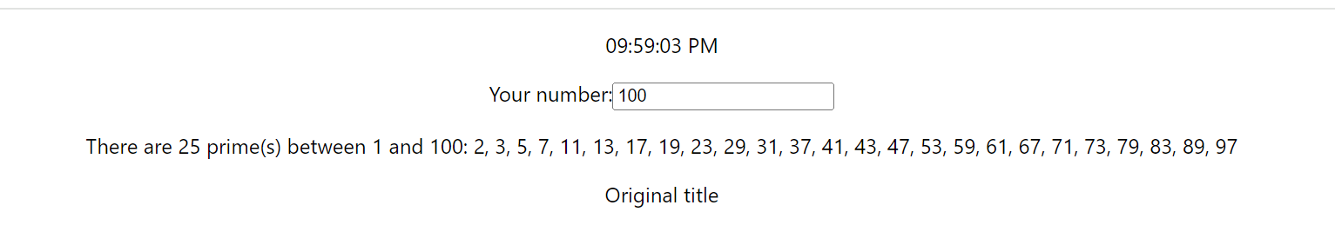
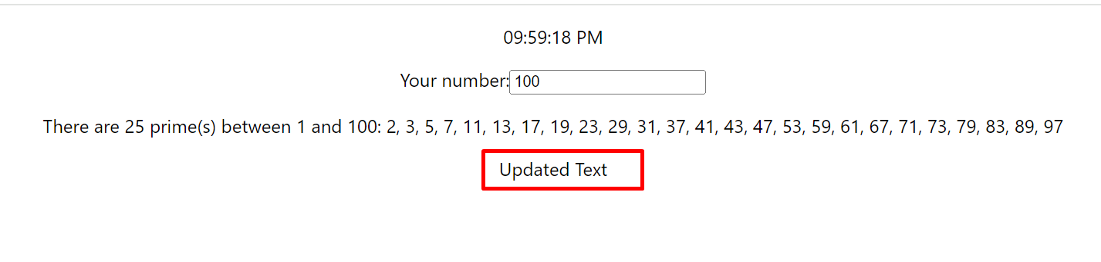
Run the application and check output.

Slide 33
A Ref variable in React is a mutable object, but the value is persisted by React across re-renders.
A ref object has a single property named current making refs have a structure similar to { current: ReactElementReference }.
The decision by the React Team to make refs persistent and mutable should be seen as a wise one.
For example, during the re-rendering of a component, the DOM element may get updated during the process, then it is necessary for the ref to the DOM element to be updated too, and if not updated, the reference should be maintained.
This helps to avoid inconsistencies in the final rendering.

Slide 34
EXPLICITLY UPDATING THE VALUE OF A useRef VARIABLE #

Slide 35
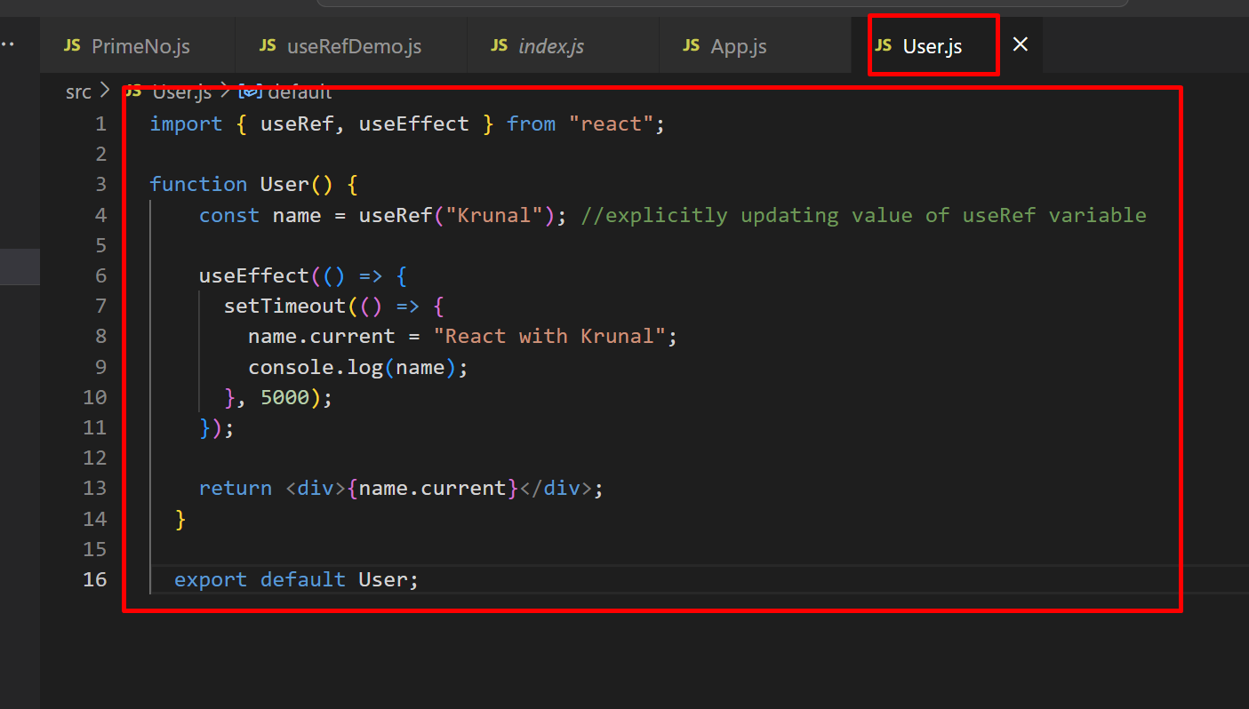
Create new file User.js

Slide 36
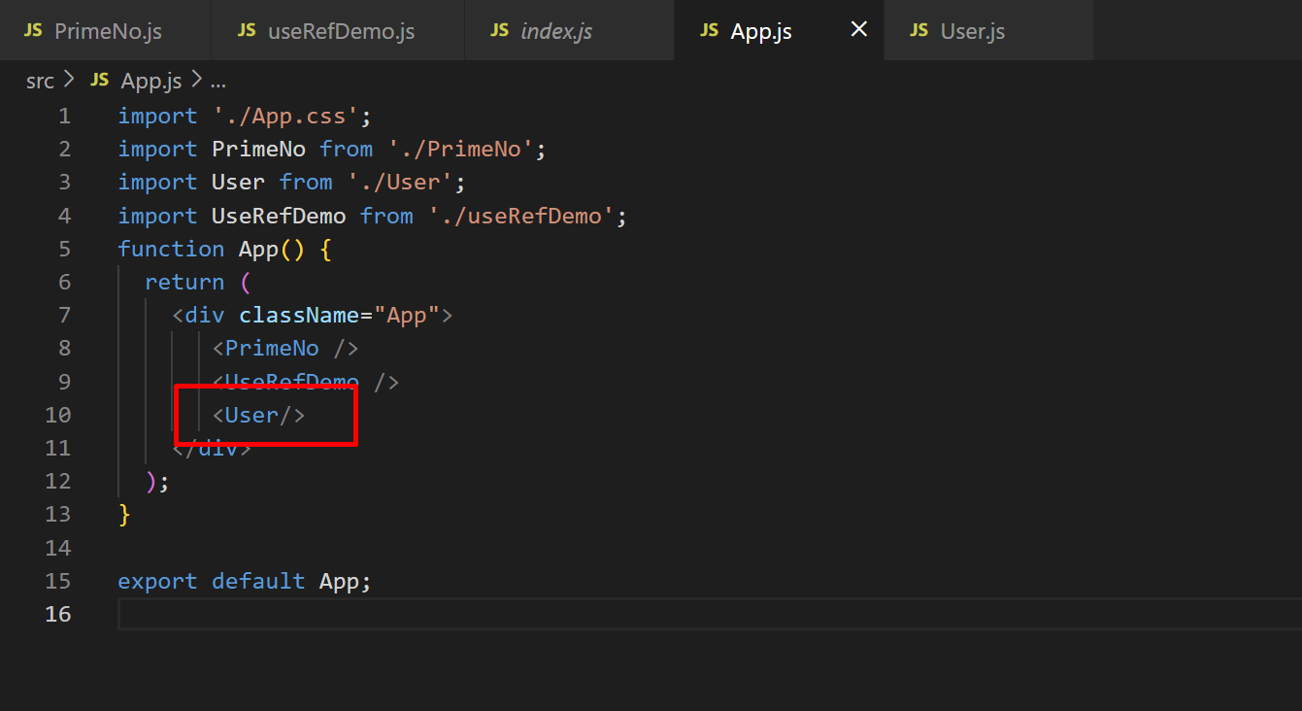

Slide 37
Run app and check output.
Check what you get in console.

Slide 38
The update to a useRef variable, the new value can be assigned to the .current of a ref variable. This should be done with caution when a ref variable is referencing a DOM element which can cause some unexpected behavior, aside from this, updating a ref variable is safe.

Slide 39
Storing Values In useRef #
A unique way to implement a useRef hook is to use it to store values instead of DOM references.
These values can either be a state that does not need to change too often or a state that should change as frequently as possible but should not trigger full re-rendering of the component.

Slide 40
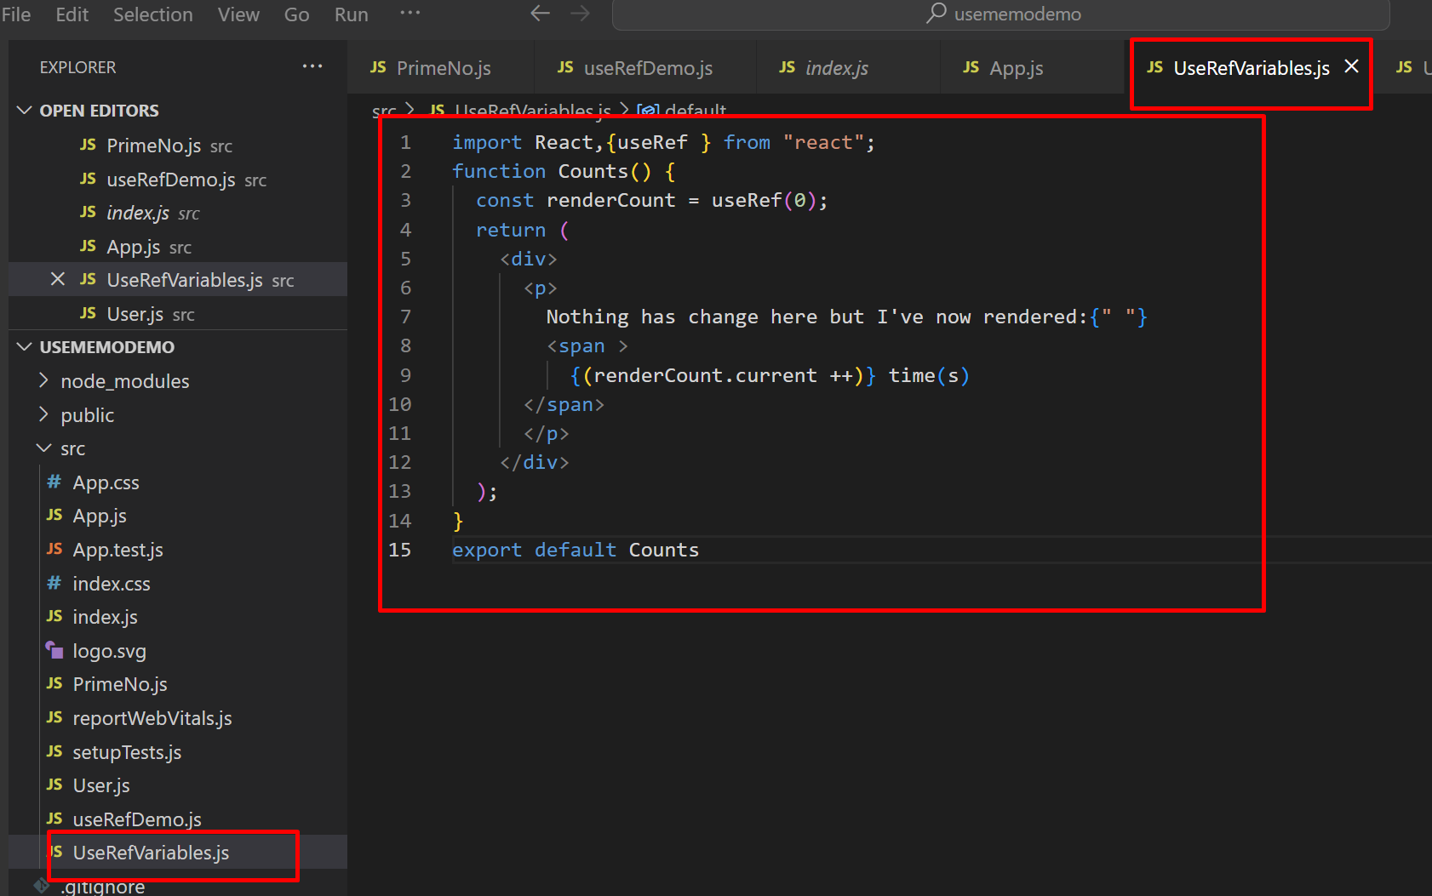
Create new file UseRefVariable.js and add the code

Slide 41
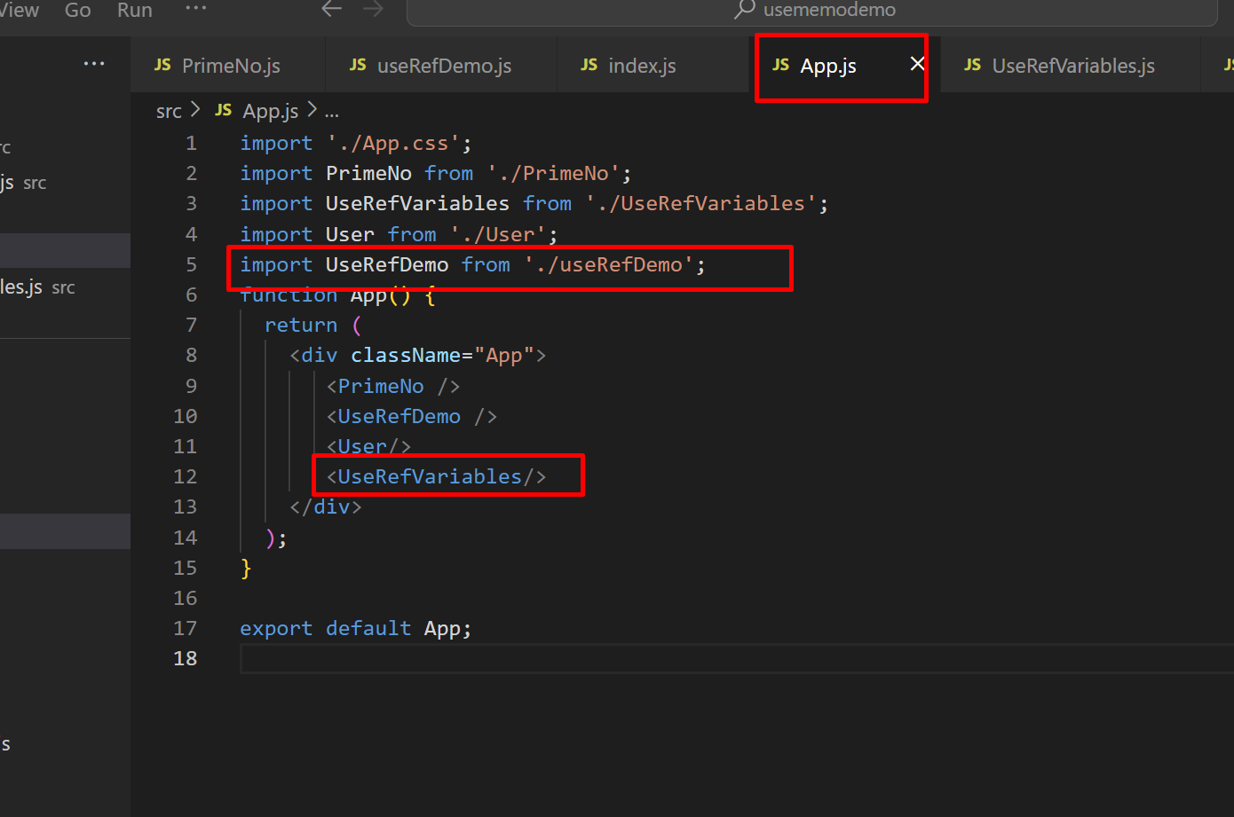
Import it to App.js

Slide 42
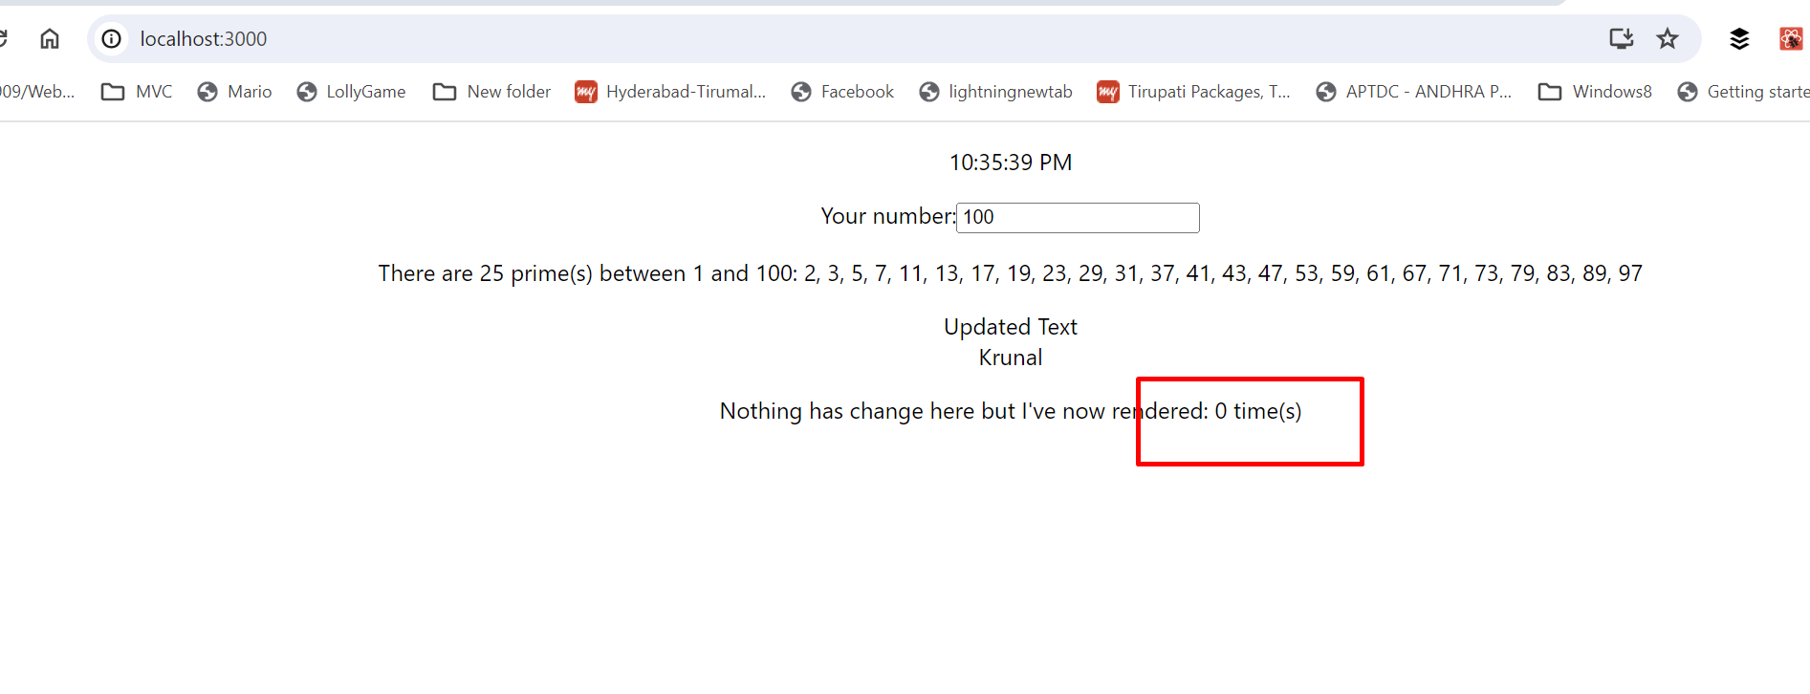
Run app and check output.

Slide 43
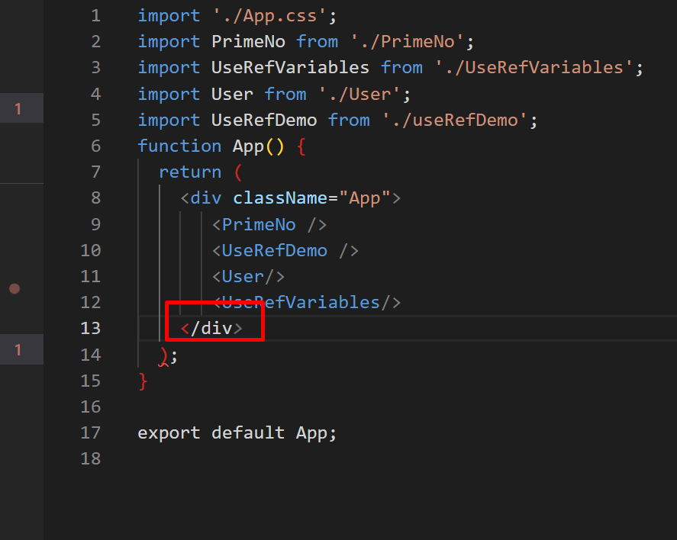
Without restarting, update anything in the file and save and check output. I re-write the div and save

Slide 44
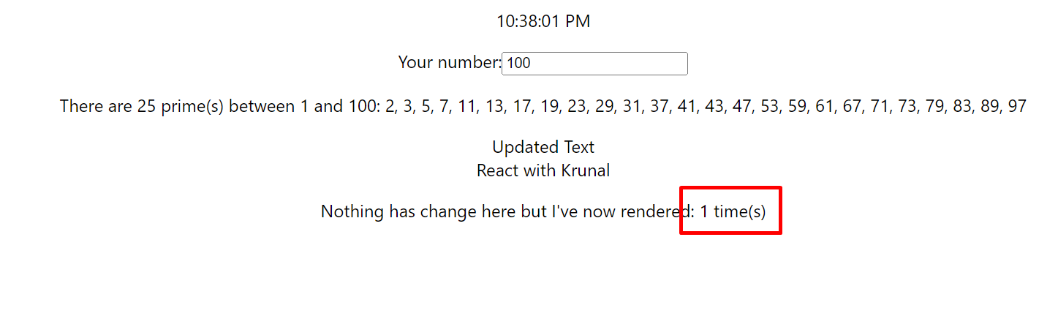
It updates the value. Why?

Slide 45
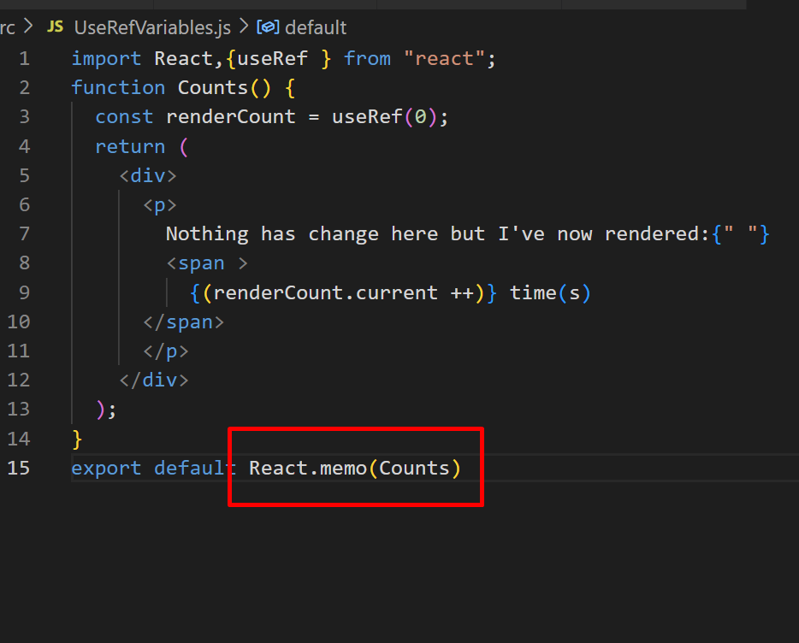
Now, wrap the Counts component in the React.memo() and guess the output.

Slide 46
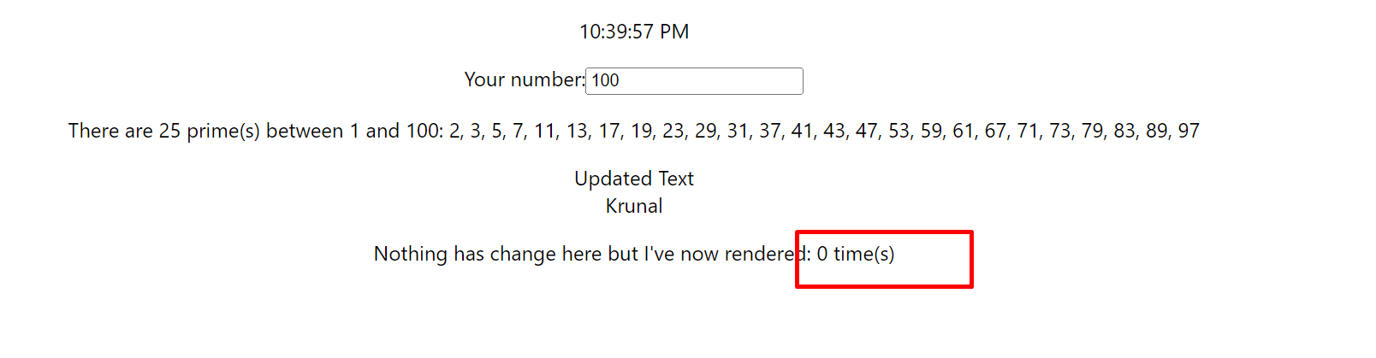
It’s always 0. Here because of React.memo() counts component does not re-render.

